Slide 1
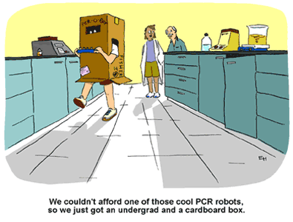
BB2950 Day 4: Monday 10-30-17
Learning objectives:
Define denaturation, melting point/Tm, and annealing with respect to nucleic acids
Define “PCR,” diagram how it works, and list a few situations in which it is useful.
https://www.promegaconnections.com/pcr-cloning-answers-to-some-frequently-asked-questions/

Slide 2
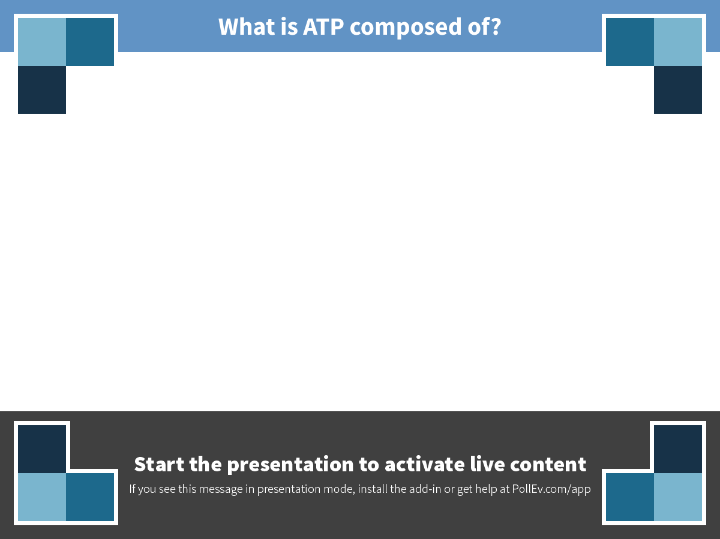
Notes:
What is ATP composed of?
https://www.polleverywhere.com/free_text_polls/57yuo5fGZkWD4QT

Slide 3
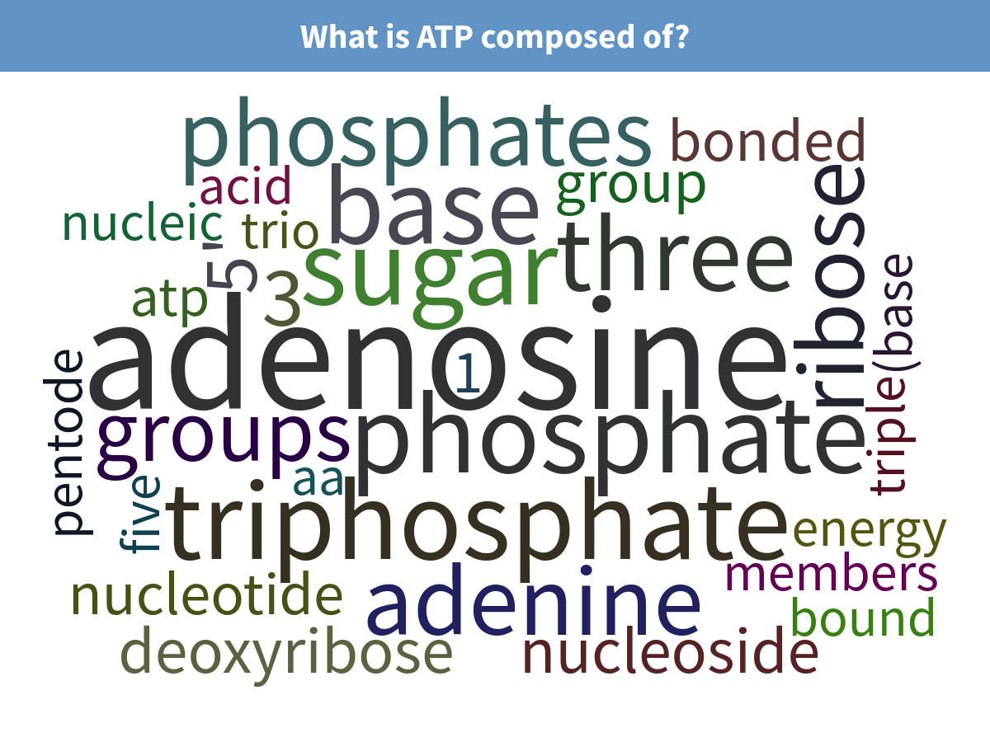
Examples of correct answers: “Adenosine and triphosphate;” “Adenine, ribose, and triphosphate.”
Notes:
What is ATP composed of?

Slide 4
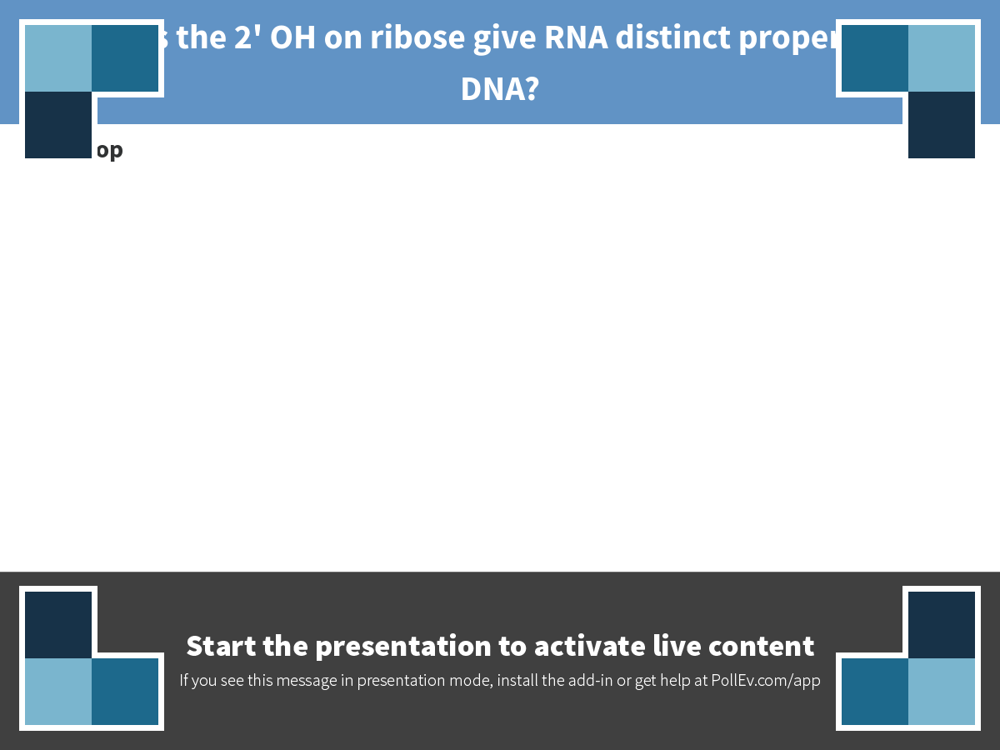
Notes:
How does the 2' OH on ribose give RNA distinct properties from DNA?
https://www.polleverywhere.com/discourses/xFZVMJ8AfnvSpMY

Slide 5
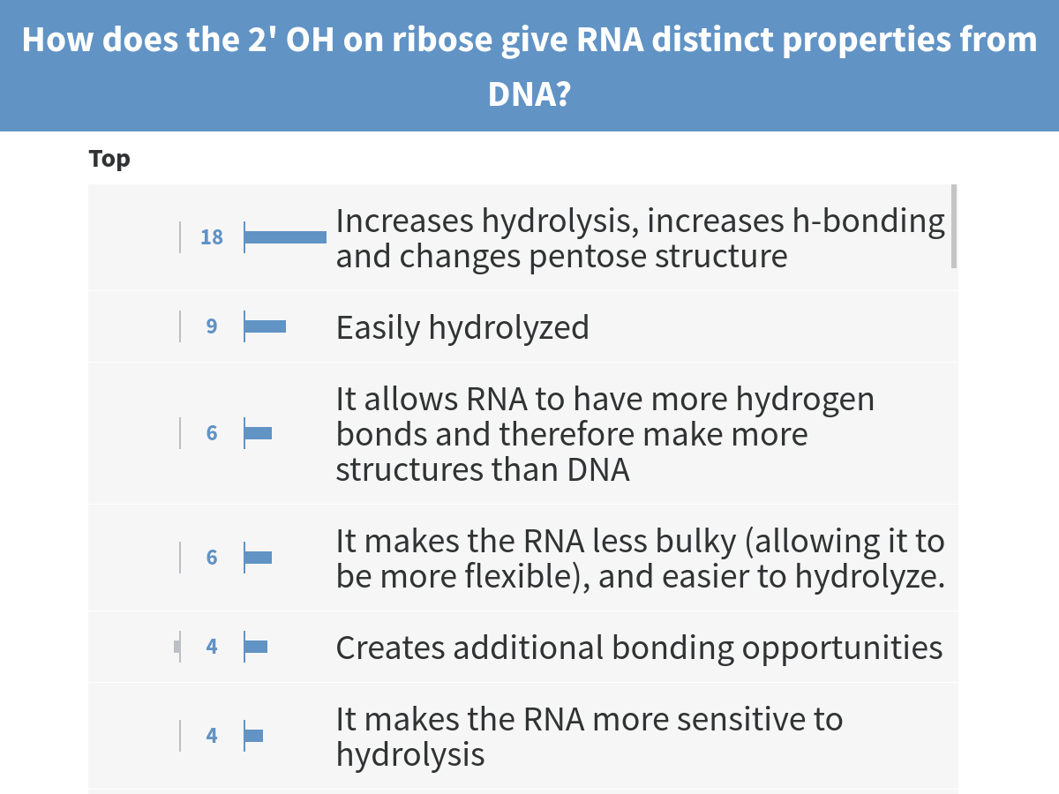
Notes:
How does the 2' OH on ribose give RNA distinct properties from DNA?

Slide 6
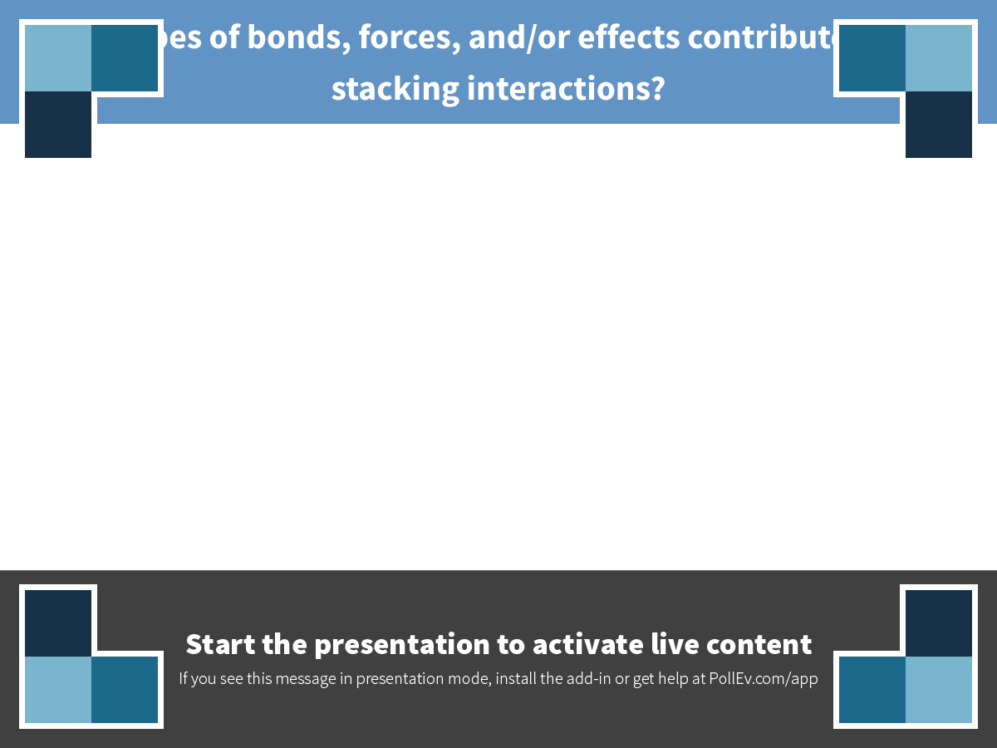
Notes:
What types of bonds, forces, and/or effects contribute to base stacking interactions?
https://www.polleverywhere.com/free_text_polls/6NKYzVQUjwRa6Vd

Slide 7
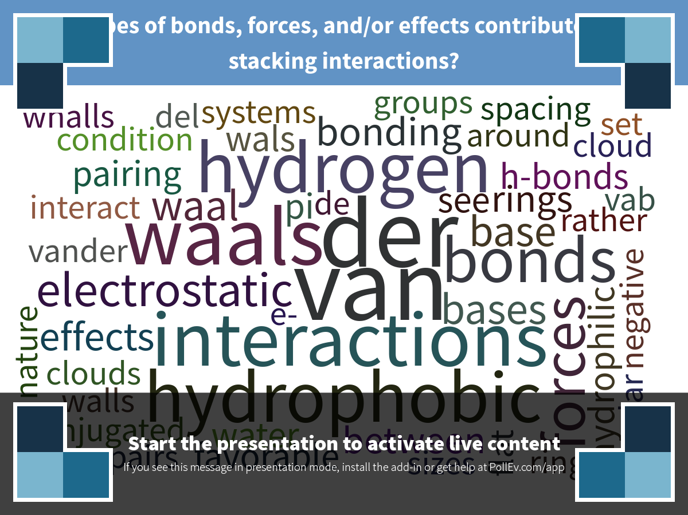
Correct answers: van der Waals forces, hydrophobic effect, electrostatic interactions.
Notes:
Poll Title: What types of bonds, forces, and/or effects contribute to base stacking interactions? https://www.polleverywhere.com/free_text_polls/6NKYzVQUjwRa6Vd

Slide 8
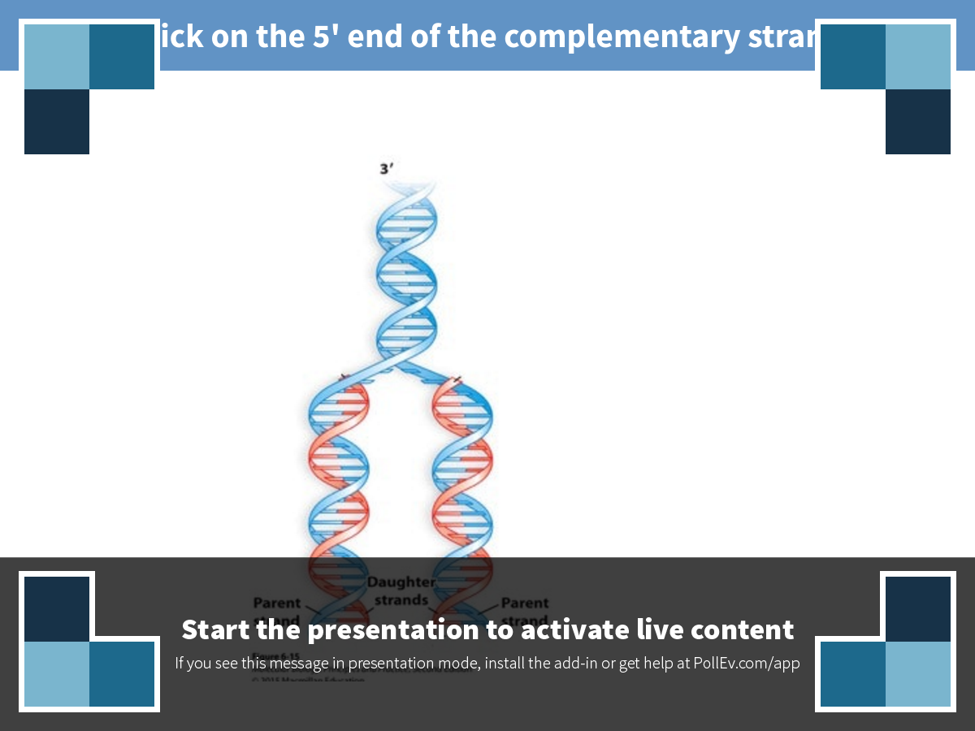
Notes:
Click on the 5' end of the complementary strand
https://www.polleverywhere.com/clickable_images/lTgTKtCENDtNVLU

Slide 9
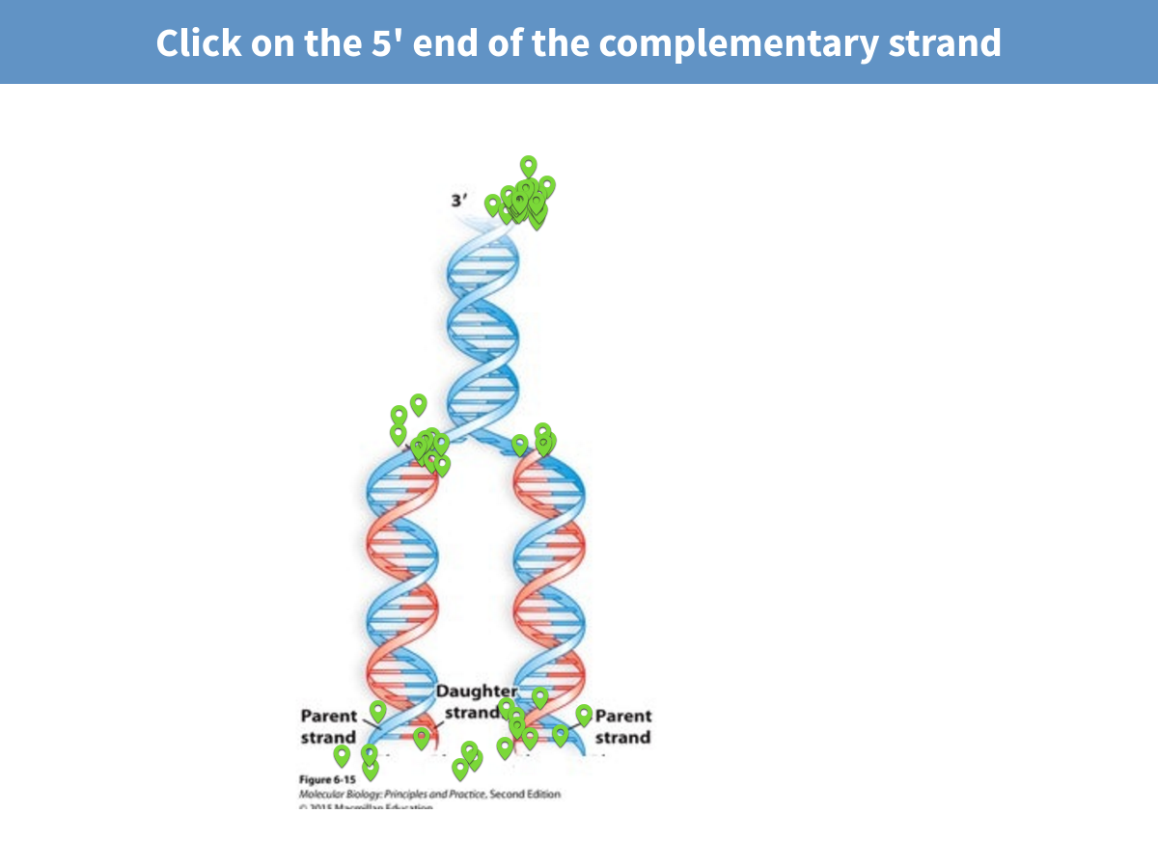
Notes:
Click on the 5' end of the complementary strand

Slide 10
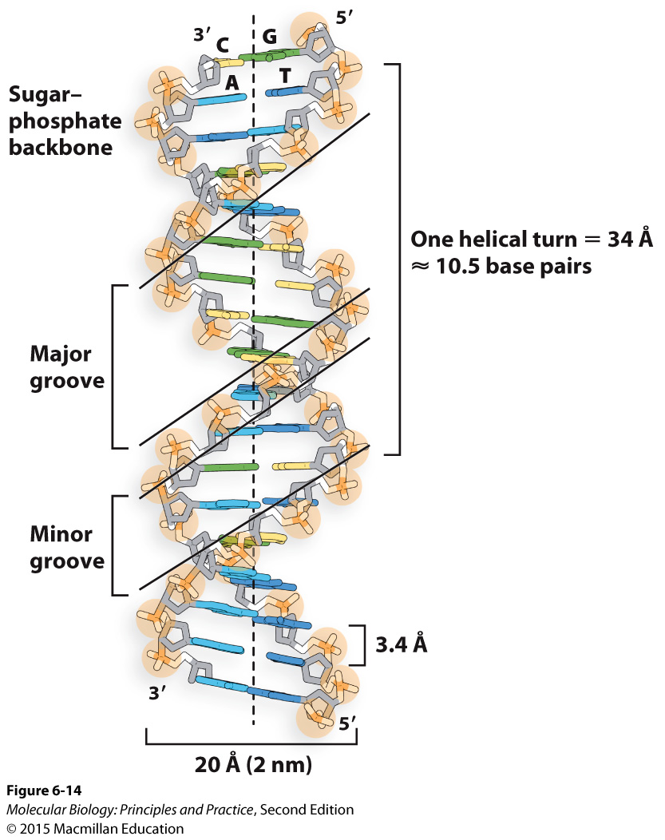
The combination of base-pairing and base stacking (many weak interactions) hold double helices together.
The shape is also influenced by repulsion between negatively charged phosphates.
The helix is asymmetric: major and minor grooves.
Strands are antiparallel.
Notes:
Each of these bonds or interactions is individually weak; their sum is strong.

Slide 11
Why is it useful for DNA duplexes to be held together by many weak bonds?
Notes:
Each of these bonds or interactions is individually weak; their sum is strong.

Slide 12
The polymerase chain reaction (PCR)
Goal: make a large number of copies of (amplify) a specific DNA sequence.
Why?
Notes:
Solicit reasons why you might need to do this
Sequence one particular gene from an entire genome to see if it has a mutation (is this strain of TB resistant to antibiotics? Do I have a mutation that increases my risk of breast cancer?)
Recombinant DNA technology (I want to engineer my E. coli to produce insulin)
Analyze very small amounts of DNA (DNA from a mummy or a crime scene)
IT REALLY COMES IN HANDY! PCR is a step in many of the methods we will talk about in this course.

Slide 13
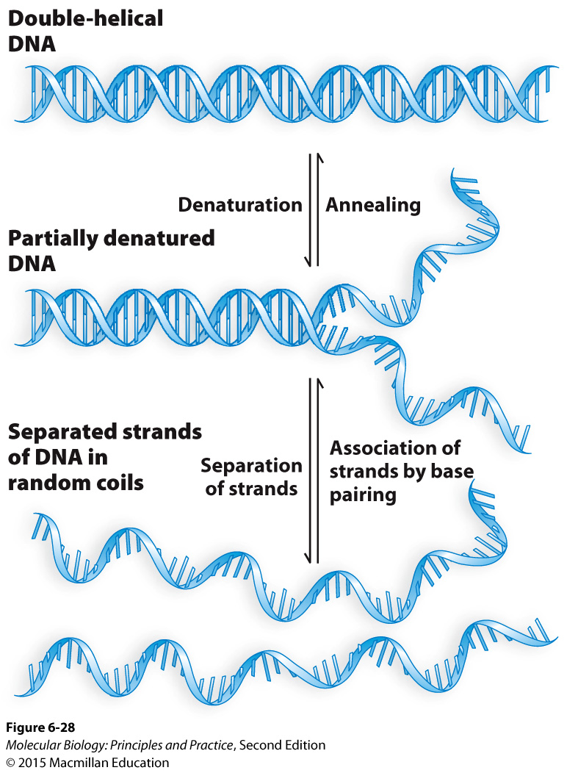
Denaturation and annealing
Notes:
Define Tm: temperature where half of the basepairs are denatured and half are annealed, on average.

Slide 14
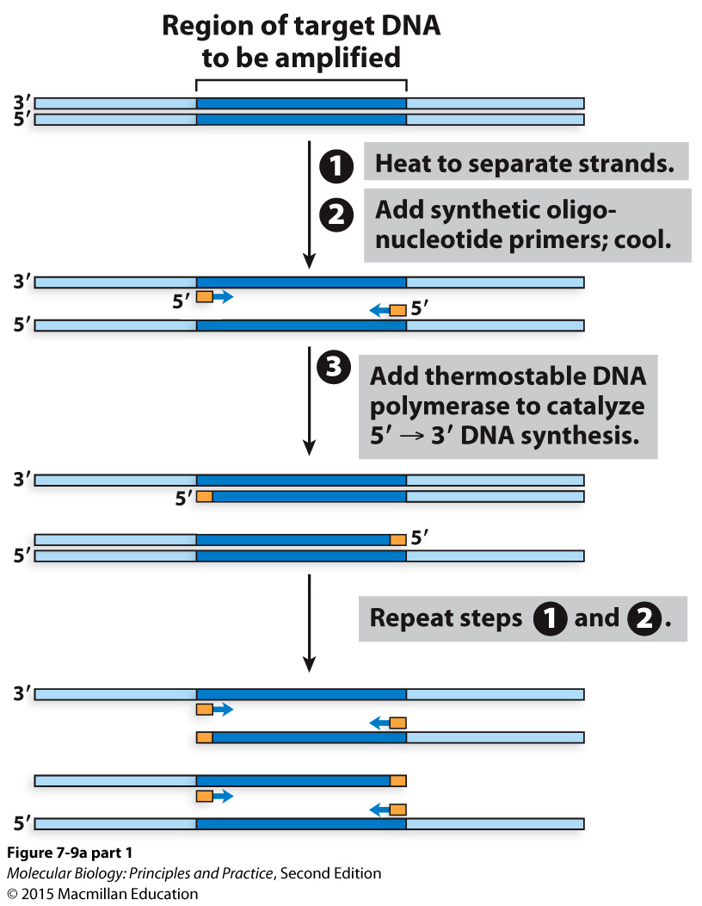
The polymerase chain reaction (PCR)

Slide 15
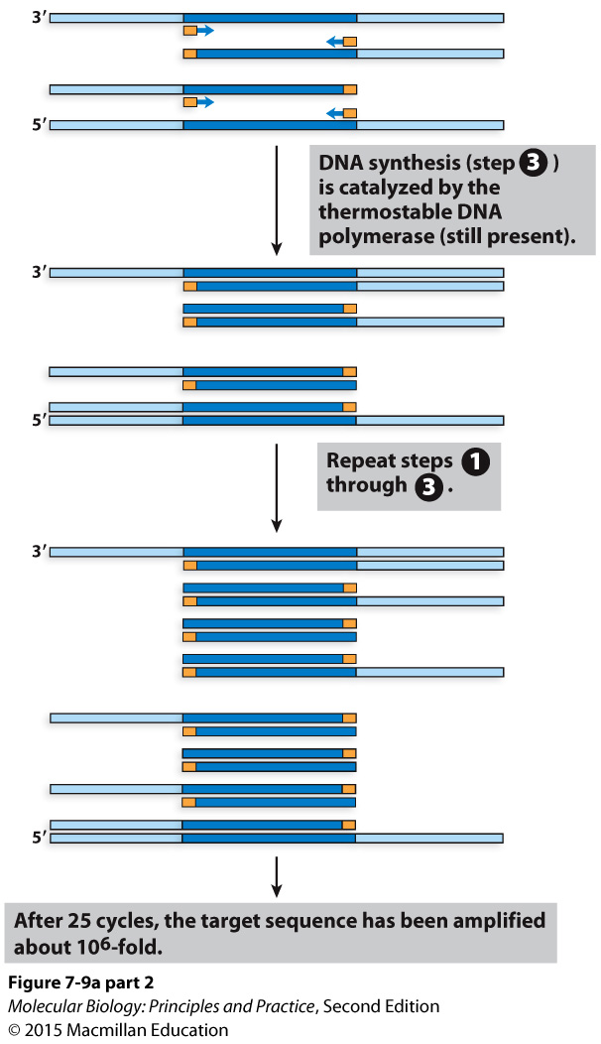
The polymerase chain reaction (PCR)

Slide 16
Typical temperatures used for PCR:
Denaturation: 95 degrees C
Annealing: 50-65 degrees C
Extension: 72 degrees C

Slide 17
The power of exponential amplification: by what factor is a given DNA fragment multiplied?
Notes:
2^number of cycles
25 cycles: 33 million fold amplification.

Slide 18
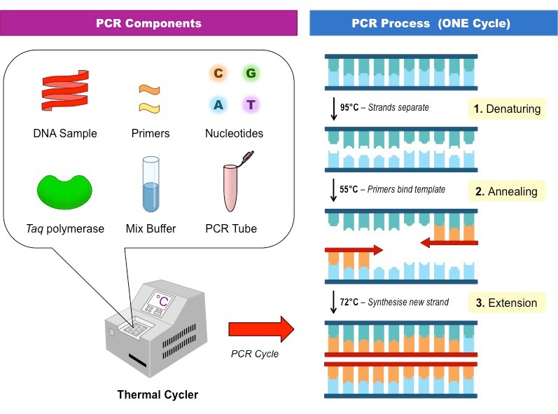
Template DNA
Specific primers
Thermo-stable DNA polymerase
dNTPs
An appropriate buffer
What need to do PCR:
http://ib.bioninja.com.au

Slide 19
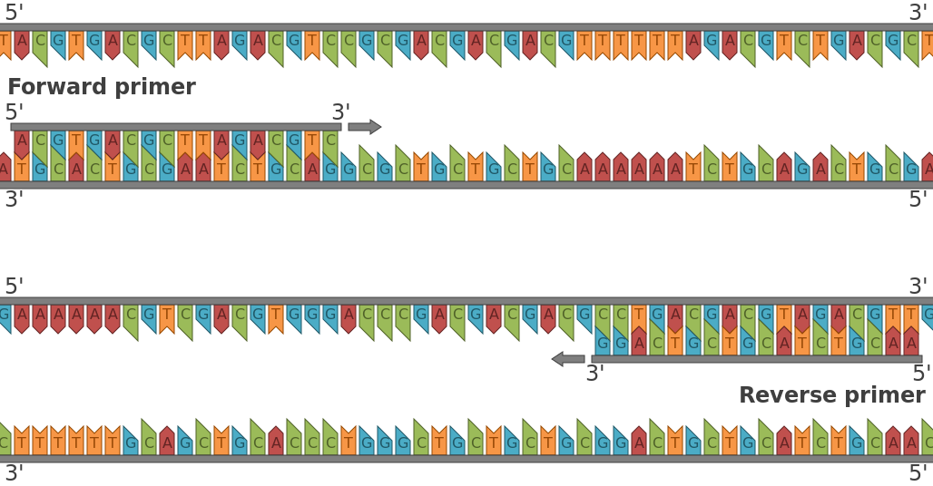
DNA polymerase always adds nts on to the
3’ end of a primer
Richard Wheeler (Zephyris), Wikimedia Commons

Slide 20
Suppose your primers only needed to be 6 nt long. What primer sequences would you use to amplify the red sequence?
5’-ttggcagattcccgccagagcaaaacagccgctagtcctagtccg-3’
3’-AACCGTCTAAGGGCGGTCTCGTTTTGTCGGCGATCAGGATCAGGC-5’

Slide 21
Suppose your primers only needed to be 6 nt long. What primer sequences would you use to amplify the red sequence?
5’-ttggcagattcccgccagagcaaaacagccgctagtcctagtccg-3’
3’-AACCGTCTAAGGGCGGTCTCGTTTTGTCGGCGATCAGGATCAGGC-5’

